Slide 1

Job Tracker
A full-stack job application tracker with Kanban workflow and file attachments
Tech Stack: .NET 8 platform/framework
Minimal API Style
EF Core – No raw SQL queries
React – Modern components
JWT – User auth
AWS S3 – External File Storage

Slide 2
Problem Statement
Why this project exists
I noticed I wanted to keep track of certain companies I have applied to.
This project is for me to track jobs across different companies. Most companies have their own dash board but I needed a centralized place.
Yes maybe LinkedIn can hold all of the applications I have done there but I wanted to be able to customize the information shared. For example, notes for the job.
I also really wanted to challenge myself so I can grow. I really needed something beyond coursework that I could work on and test my skills.

Slide 3

High-Level Architecture
How the system is structured
• Frontend: React (UI + state)
• Backend: .NET 8 Minimal API (business logic)
• Database: SQLite / PostgreSQL (relational data)
• Auth: JWT (stateless authentication)
• Storage: AWS S3 (attachments)
There is a clear separation of concerns

Slide 4

Codebase Map (Important Files)
How the project is organized
Frontend
• JobAppsPage.tsx – main page + data loading • client.ts – shared API client • useAuth.ts – auth state & JWT handling
Backend
• Program.cs – middleware & pipeline • JobAppEndpoints.cs – feature endpoints • AppDbContext.cs – EF Core data access
This slide proves you understand your own codebase.

Slide 5
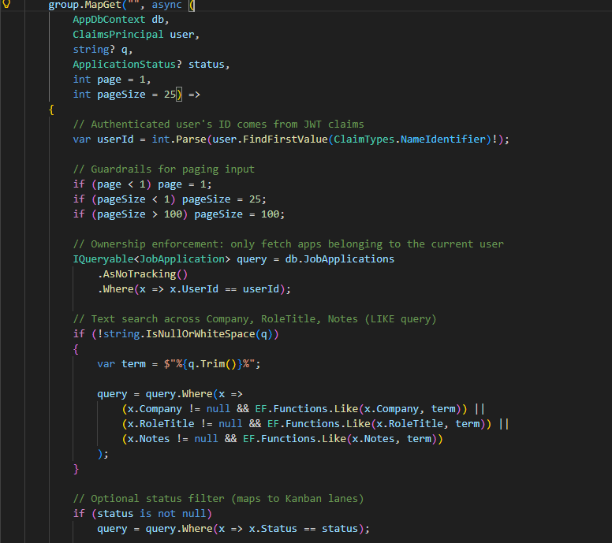
Core Code Block #1 (Backend Logic)
This endpoint lists job applications for the logged-in user.
I get the user ID from the JWT claims using NameIdentifier.
Ownership is enforced at the query level with Where(UserId == userId) so users can never access someone else’s data.
I use EF Core with IQueryable so filters like search, status, and paging compose cleanly before the SQL is executed.
AsNoTracking() improves read performance since this is a read-only list.
Paging is implemented with Skip and Take to prevent returning large result sets.
I return DTOs instead of entities so the API contract remains stable and persistence details are not exposed.

Slide 6
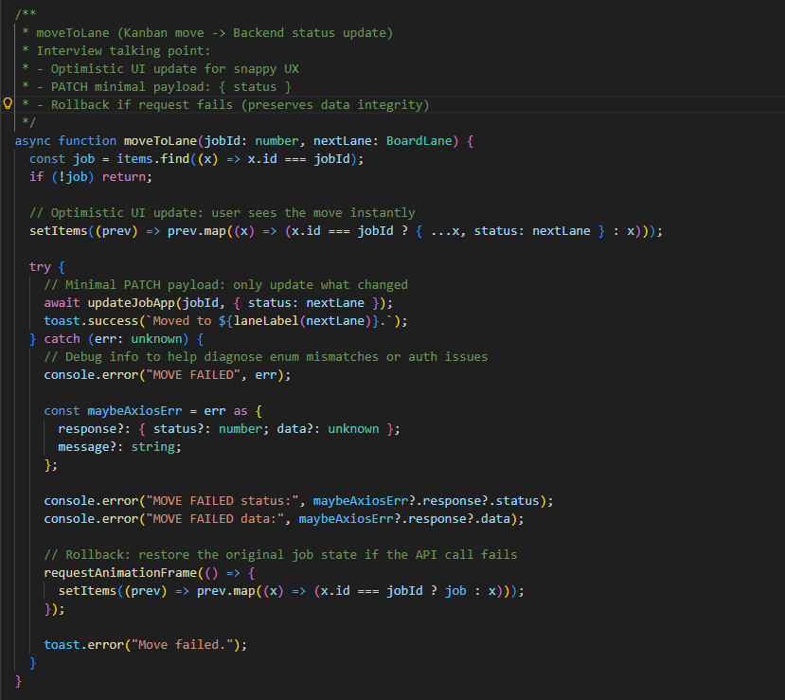
Core Code Block #2 (Frontend Logic)
Handles Kanban drag-and-drop status changes
Uses optimistic UI updates for immediate feedback
Sends minimal PATCH request to backend API
Rolls back UI state if the request fails
Keeps frontend state consistent with backend data

Slide 7

Data and Security Design
JWT-based authentication on every request
Authorization enforced at the data access layer
EF Core queries scoped by authenticated user
Attachments stored in AWS S3 with metadata in the database
Defense-in-depth across frontend and backend

Slide 8
Tradeoffs and Design Decisions
Minimal APIs for explicit routing and reduced boilerplate
EF Core for strongly typed data access and provider flexibility
Optimistic UI updates balanced with rollback logic
Separate attachment handling for clean boundaries
Simplicity prioritized where appropriate

Slide 9
Challenges and What I Learned
Keeping UI state shareable and refresh safe
Preventing stale API responses during rapid changes
Ensuring frontend and backend enums stay aligned
Balancing rich interactions with predictable behavior

Slide 10

Wrapping up & Demo
Live demo of core workflows: https://jobtracker-b0k3.onrender.com
Quick codebase orientation
Key takeaways from the project
Open to questions and deep dives

